Slide 1

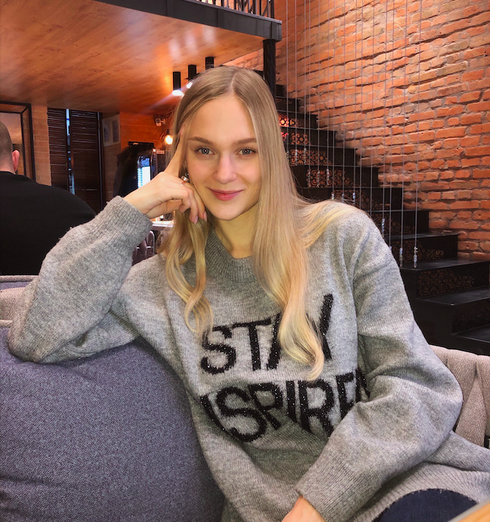
Daria Solodey
Methodist, course creator, English teacher

Slide 2
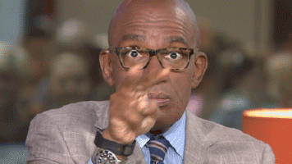
🔥
Our goal
Pass a job interview
Our rules:
Turn on your camera
Set up your microphone
Be active
Notes:
Если вам не хватило места, вы можете здесь написать развернутый комментарий.

Slide 3

Lesson Plan:
discuss what body language is and how to use it properly
how to present a project
Notes:
Развернутый комментарий.

Slide 4
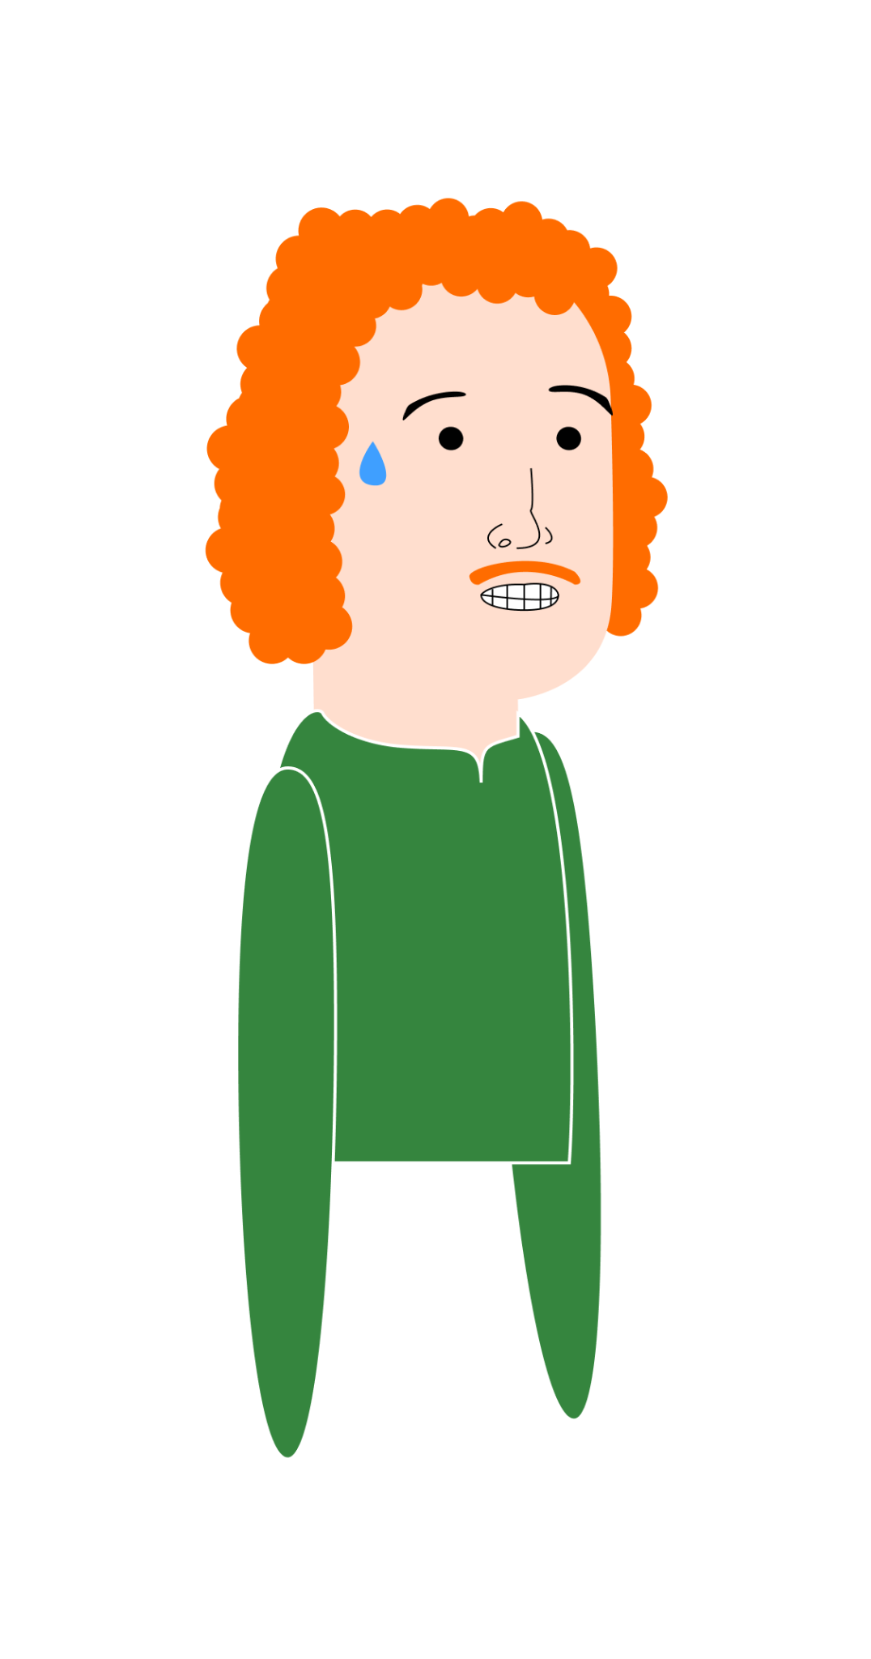
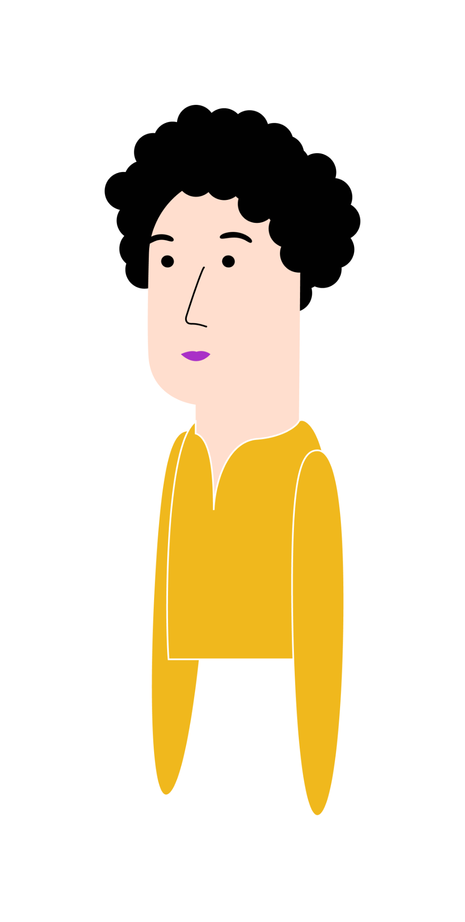
What is the difference between verbal and non-verbal communication?
What is body language? Do you think it’s important?
Do you pay attention to other people’s body language when you talk to them? Why?
How can our body language affect the first impression we make?
Are you good at controlling your body language?

Slide 5
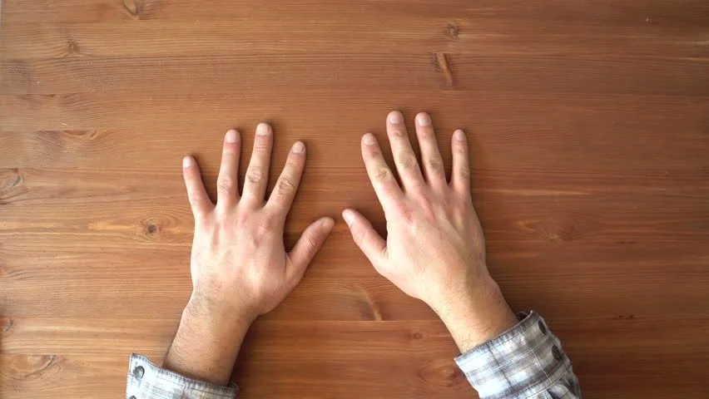
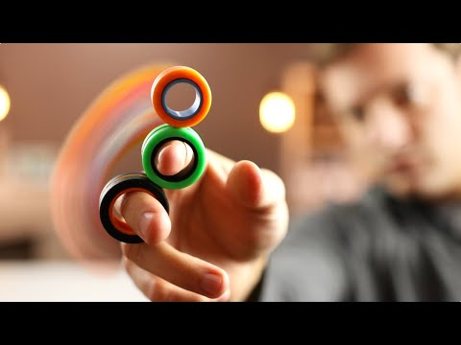


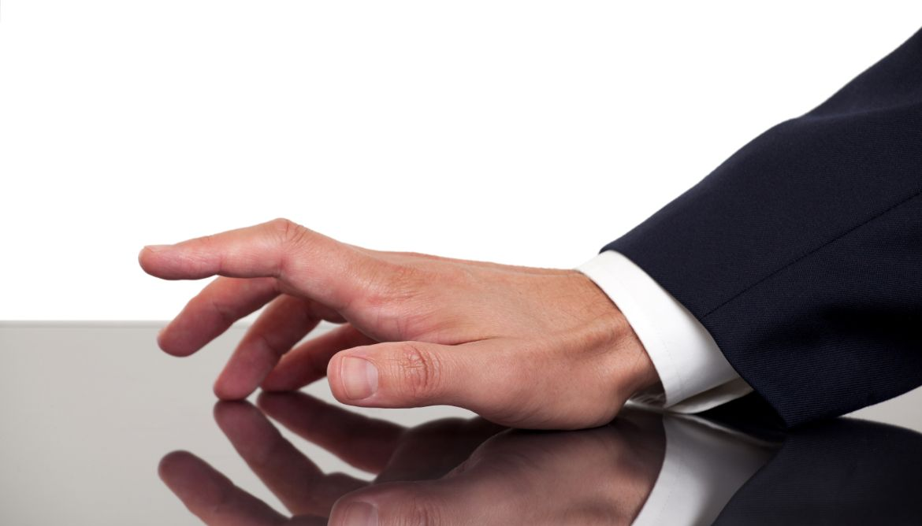

Match the words and the pictures
to put out a confidence vibe, to steeple fingers, to hide palms, to fidget fingers,
to tap fingers, to fold arms
1.
2.
3.
4.
5.
6.

Slide 6
Match the words and the pictures
to put out a confidence vibe, to steeple fingers, to hide palms, to fidget fingers,
to tap fingers, to fold arms
1.
2.
3.
to hide palms
4.
5.
6.

Slide 7
Match the words and the pictures
to put out a confidence vibe, to steeple fingers, to hide palms, to fidget fingers,
to tap fingers, to fold arms
1.
2.
3.
to hide palms
to fidget fingers
4.
5.
6.

Slide 8
Match the words and the pictures
to put out a confidence vibe, to steeple fingers, to hide palms, to fidget fingers,
to tap fingers, to fold arms
1.
2.
3.
to hide palms
to fidget fingers
to fold arms
4.
5.
6.

Slide 9
Match the words and the pictures
to put out a confidence vibe, to steeple fingers, to hide palms, to fidget fingers,
to tap fingers, to fold arms
1.
2.
3.
to hide palms
to fidget fingers
to fold arms
4.
5.
6.
to put out a confidence vibe

Slide 10
Match the words and the pictures
to put out a confidence vibe, to steeple fingers, to hide palms, to fidget fingers,
to tap fingers, to fold arms
1.
2.
3.
to hide palms
to fidget fingers
to fold arms
4.
5.
6.
to put out a confidence vibe
to tap fingers

Slide 11
Match the words and the pictures
to put out a confidence vibe, to steeple fingers, to hide palms, to fidget fingers,
to tap fingers, to fold arms
1.
2.
3.
to hide palms
to fidget fingers
to fold arms
4.
5.
6.
to put out a confidence vibe
to tap fingers
to steeple fingers

Slide 12
What do these actions mean?
showing palms
steepling
hiding palms
concealing palms
fidgeting, tapping fingers
folding arms
impatience
dominance
defense, insecurity
truth, honesty, allegiance
putting out a confidence vibe
you have something to hide
⁉️

Slide 13
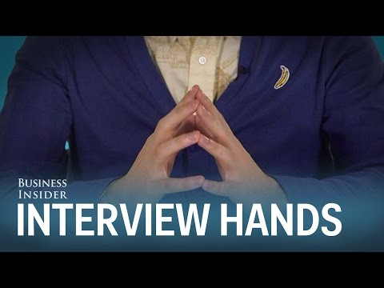
Watch the video about what to do with your hands during a job interview.
What are dos and don’ts?

Slide 14
LET’S CHECK!
showing palms
steepling
hiding palms
concealing palms
fidgeting, tapping fingers
folding arms
impatience
dominance
truth, honesty, allegiance
defense, insecurity
putting out a confidence vibe
you have something to hide

Slide 15
LET’S CHECK!
showing palms
steepling
hiding palms
concealing palms
fidgeting, tapping fingers
folding arms
impatience
dominance
truth, honesty, allegiance
defense, insecurity
putting out a confidence vibe
you have something to hide

Slide 16
LET’S CHECK!
showing palms
steepling
hiding palms
concealing palms
fidgeting, tapping fingers
folding arms
impatience
dominance
truth, honesty, allegiance
defense, insecurity
putting out a confidence vibe
you have something to hide

Slide 17
LET’S CHECK!
showing palms
steepling
hiding palms
concealing palms
fidgeting, tapping fingers
folding arms
impatience
dominance
truth, honesty, allegiance
defense, insecurity
putting out a confidence vibe
you have something to hide

Slide 18
LET’S CHECK!
showing palms
steepling
hiding palms
concealing palms
fidgeting, tapping fingers
folding arms
impatience
dominance
truth, honesty, allegiance
defense, insecurity
putting out a confidence vibe
you have something to hide

Slide 19
LET’S CHECK!
showing palms
steepling
hiding palms
concealing palms
fidgeting, tapping fingers
folding arms
impatience
dominance
truth, honesty, allegiance
defense, insecurity
putting out a confidence vibe
you have something to hide

Slide 20
LET’S CHECK!
showing palms
steepling
hiding palms
concealing palms
fidgeting, tapping fingers
folding arms
impatience
dominance
truth, honesty, allegiance
defense, insecurity
putting out a confidence vibe
you have something to hide

Slide 21
LET’S CHECK!
showing palms
steepling
hiding palms
concealing palms
fidgeting, tapping fingers
folding arms
impatience
dominance
truth, honesty, allegiance
defense, insecurity
putting out a confidence vibe
you have something to hide
Do you remember any more examples of body language?

Slide 22
Answer the questions.
Which of the tips from the video are relevant for your online interview or project presentation?
What other tips for good body language during virtual communication can you add?
Do you get nervous during online meetings as much as you would offline?

Slide 23
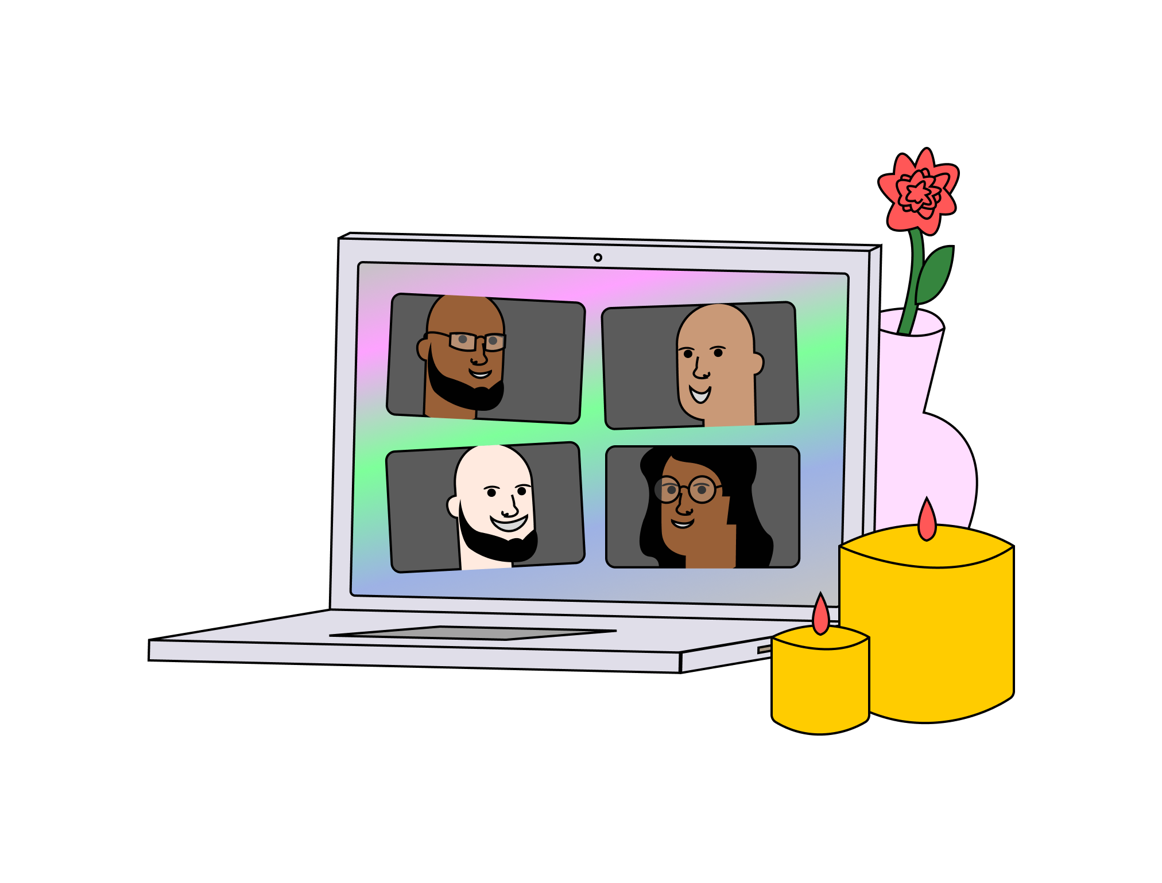
If you are tired, lean on the desk.
Touching your face throughout the meeting suggests that you are interested.
It’s important to maintain eye contact even if the meeting is virtual.
Keep smiling throughout the whole meeting.
Don’t position yourself too close to the camera.
When you speak, try to avoid using your hands.
Do you remember your homework article?
Mark TRUE or FALSE and explain why.
Notes:
Homework article

Slide 24
F
If you are tired, lean on the desk.
Touching your face throughout the meeting suggests that you are interested.
It’s important to maintain eye contact even if the meeting is virtual.
Keep smiling throughout the whole meeting.
Don’t position yourself too close to the camera.
When you speak, try to avoid using your hands.
Notes:
Homework article

Slide 25
F
F
If you are tired, lean on the desk.
Touching your face throughout the meeting suggests that you are interested.
It’s important to maintain eye contact even if the meeting is virtual.
Keep smiling throughout the whole meeting.
Don’t position yourself too close to the camera.
When you speak, try to avoid using your hands.
Notes:
Homework article

Slide 26
F
F
T
If you are tired, lean on the desk.
Touching your face throughout the meeting suggests that you are interested.
It’s important to maintain eye contact even if the meeting is virtual.
Keep smiling throughout the whole meeting.
Don’t position yourself too close to the camera.
When you speak, try to avoid using your hands.
Notes:
Homework article

Slide 27
F
F
T
F
If you are tired, lean on the desk.
Touching your face throughout the meeting suggests that you are interested.
It’s important to maintain eye contact even if the meeting is virtual.
Keep smiling throughout the whole meeting.
Don’t position yourself too close to the camera.
When you speak, try to avoid using your hands.
Notes:
Homework article

Slide 28
F
F
T
F
T
If you are tired, lean on the desk.
Touching your face throughout the meeting suggests that you are interested.
It’s important to maintain eye contact even if the meeting is virtual.
Keep smiling throughout the whole meeting.
Don’t position yourself too close to the camera.
When you speak, try to avoid using your hands.
Notes:
Homework article

Slide 29
F
F
T
F
T
F
If you are tired, lean on the desk.
Touching your face throughout the meeting suggests that you are interested.
It’s important to maintain eye contact even if the meeting is virtual.
Keep smiling throughout the whole meeting.
Don’t position yourself too close to the camera.
When you speak, try to avoid using your hands.
Notes:
Homework article

Slide 30


TIME TO SPEAK!
Notes:
OPTIONAL

Slide 31
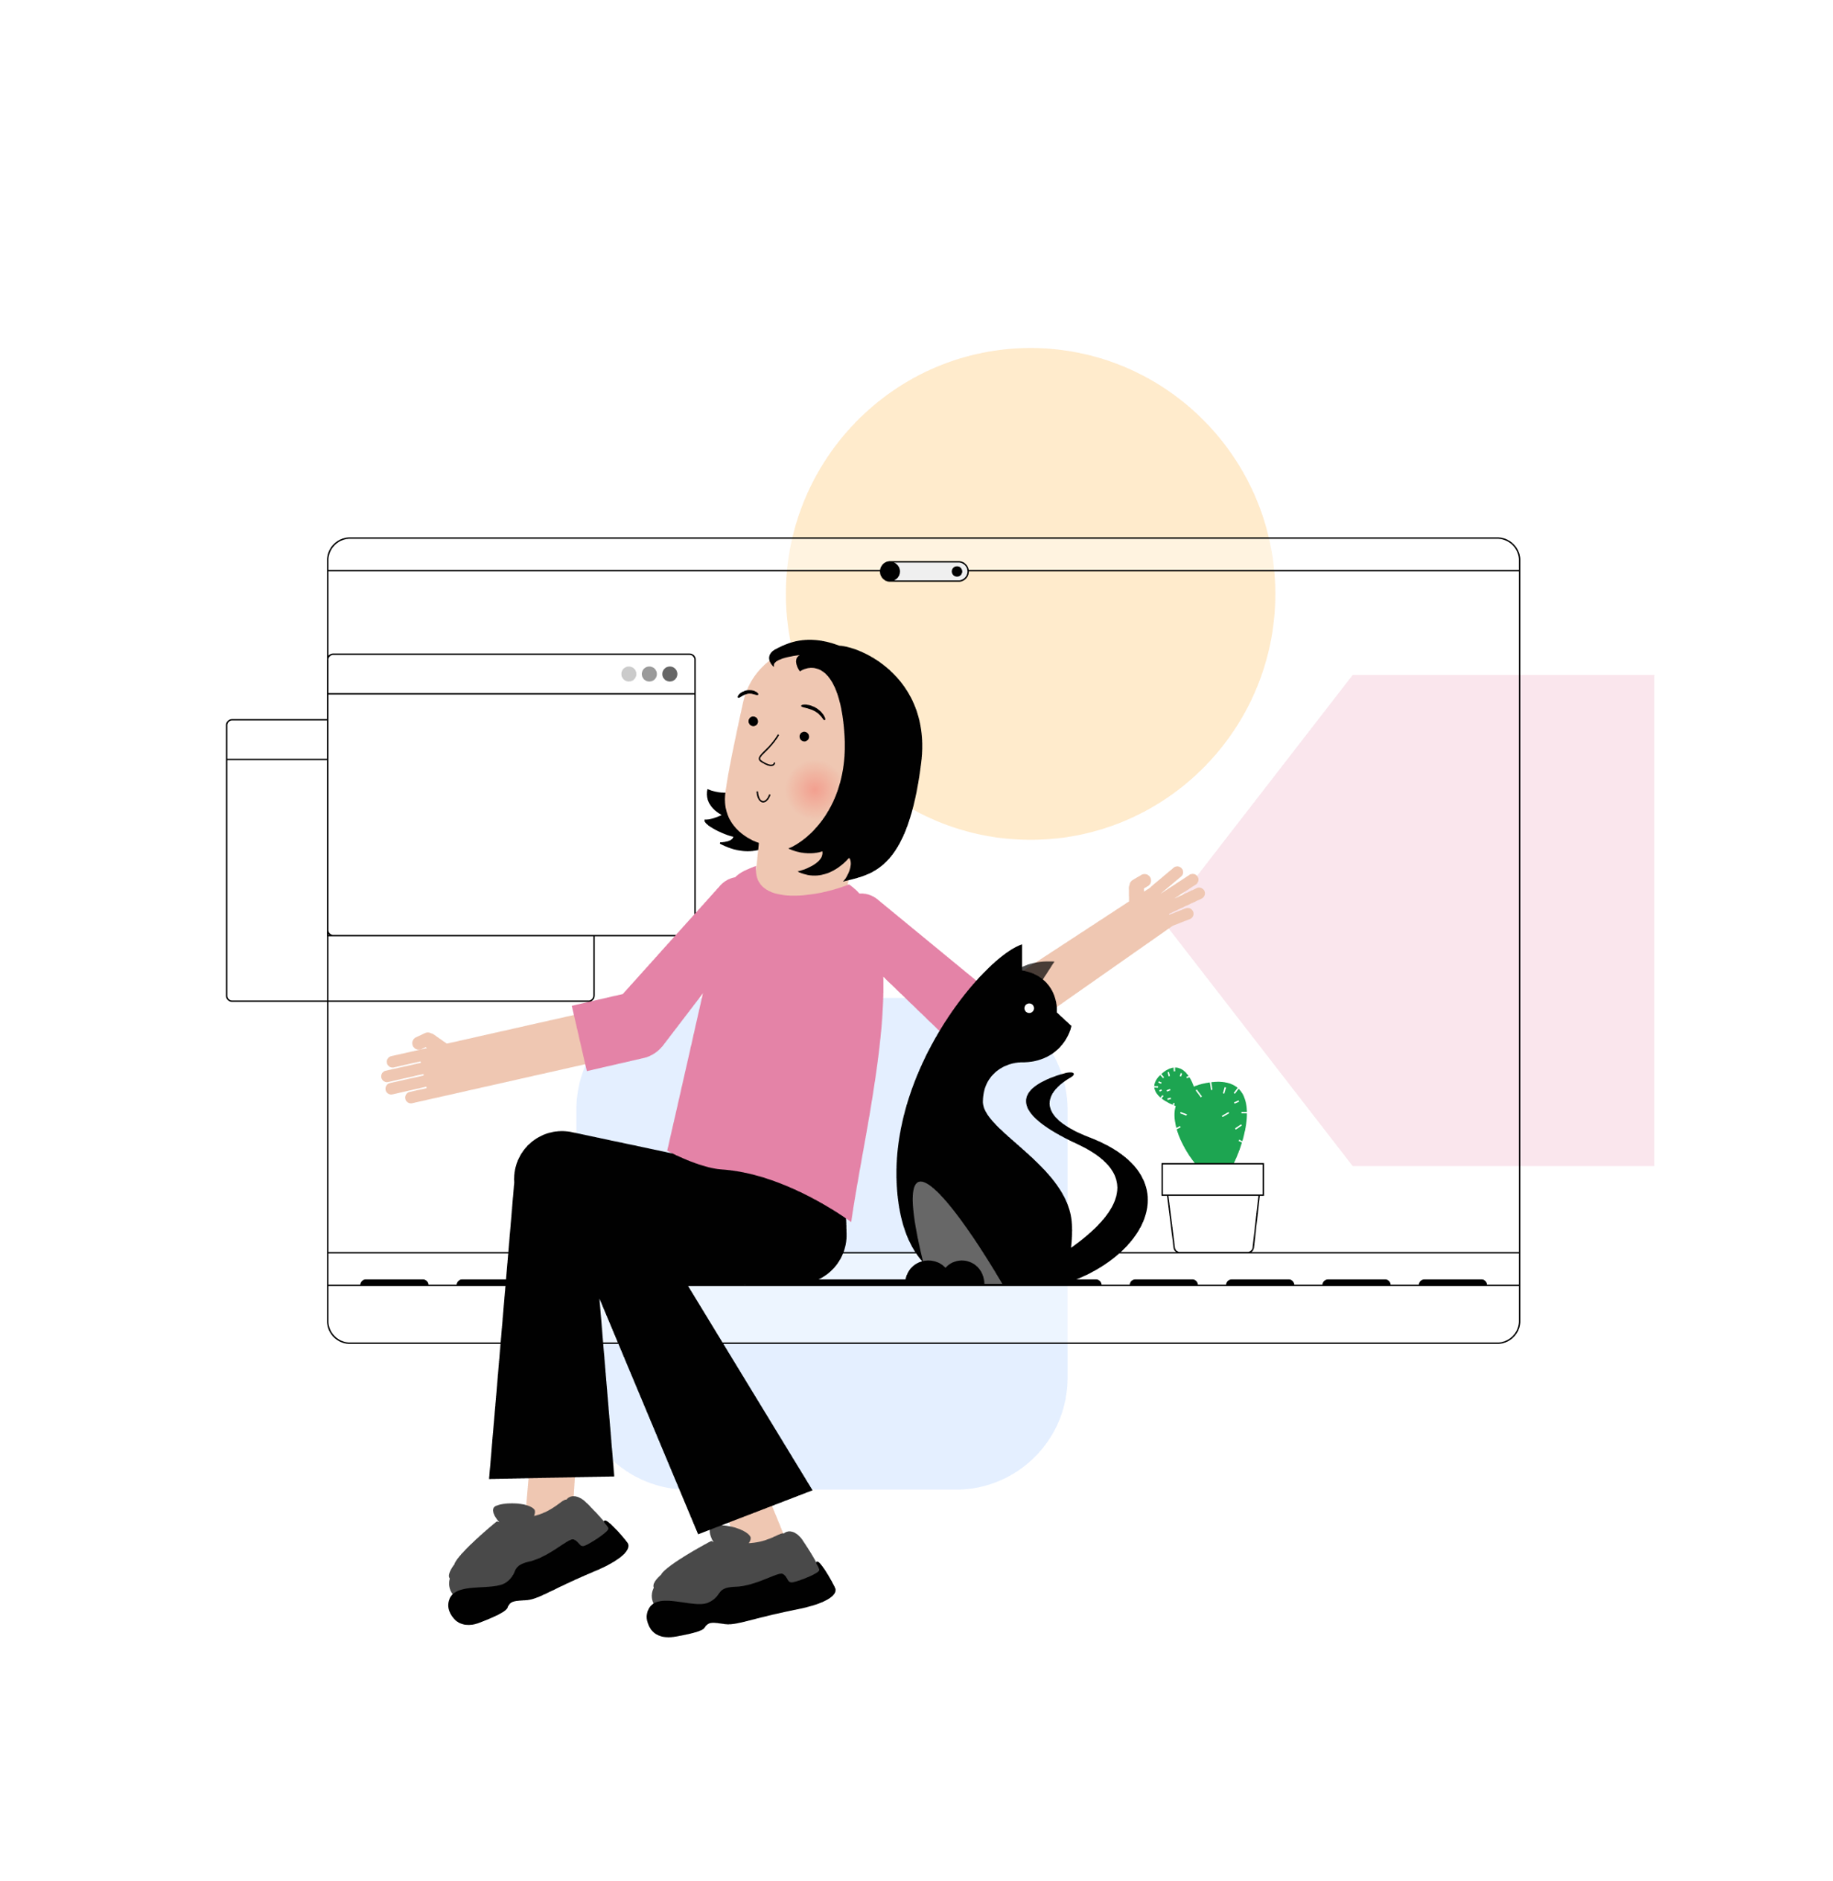
How to present a project
What is important to say when you present the project?
Notes:
JamBoard - choose the points to mention in your presentation

Slide 32

Here’s a suggested order
Purpose
Main task
Problem you faced
Problem the project solves
Benefits
Team presentation
Let’s take a look at the example of the presentation and complete the gaps

Slide 33
How to present a project
S T A R
Situation
Task
Action
Result
Good morning ladies and gentlemen. My name is Andrew and I'm a leader of our team called «Hackers».
The purpose of my talk is to present an application that tracks your personal finances.
Our main task was to create and configure a database, make the frontend component of the site, and connect the database to the frontend. In addition, we were to think through the logic of the behavior of the web application and correct data transfer from the frontend to the backend.
Throughout the project, we faced the problem of making up a data storage structure so that it was correctly updated, supplemented and created.
The project solves the problem of keeping record of your personal finances. Thanks to the application, you will always know how much money you have and how much you spend a month.
We built the app from scratch and the benefit of it is that it is convenient for us personally. We can also see detailed statistics on expenses and income.
Finally, I’d like to thank my talented team for the amazing job they did. We all worked for one common goal and it could not be possible to achieve it without diligence and hard work of each of my teammates.

Slide 34
Present your project
S T A R
Situation
Task
Action
Result
The purpose of my talk is…
Our main task was to…
Throughout the project, we faced the problem of…
The project solves the problem of…
Thanks to the… , you will…
The benefit of this project is that…
I’d like to present you my team. It consists of … developers.
Finally, I’d like to thank my talented team for…
I was in charge of…
My tasks were to…

Slide 35
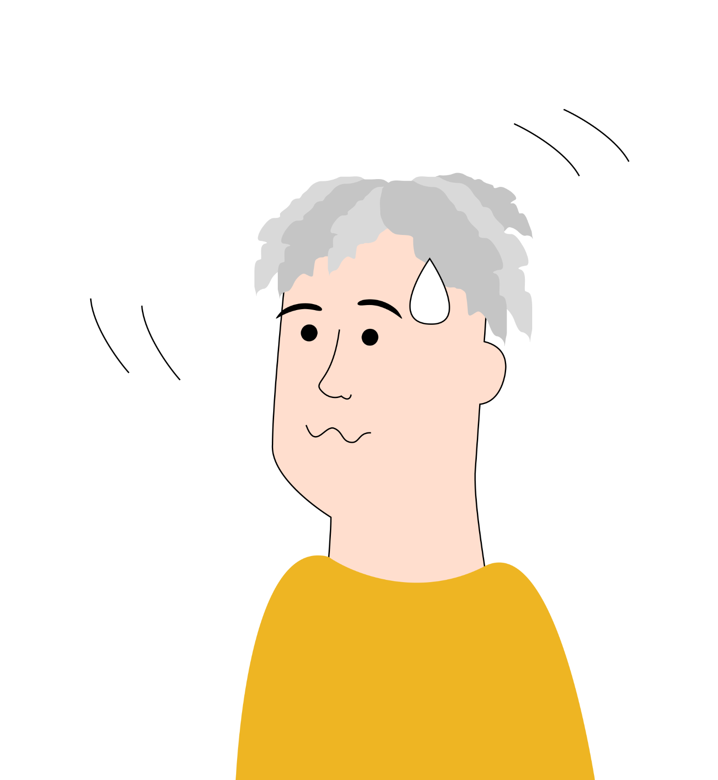
Read the article titled:
11 horrible body language mistakes that are hard to quit but you'll be glad you did
and be ready to discuss it next class

Slide 36
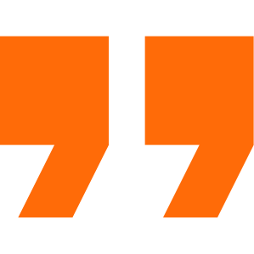
What can you do after this lesson?
I learned:
how to use body language properly
how to present a project
Notes:
Развернутый комментарий

Slide 37
Useful links:
Presentation - presentation plan
https://wordwall.net/resource/36546778 - example
HW: Terrible Body Language Habits You Need to Break

Slide 38
Thank you!
Notes:
Active link

